Slide 1
SGLang DeepSeek MLA
Ke Bao<bockbao@gmail.com>, Yineng Zhang<me@zhyncs.com>
SGLang Team

Slide 2
Outlines
1. Introduction to MLA
2. SGLang MLA Optimizations
3. How to Use MLA in SGLang
4. Future Work

Slide 3
1. Introduction to MLA

Slide 4
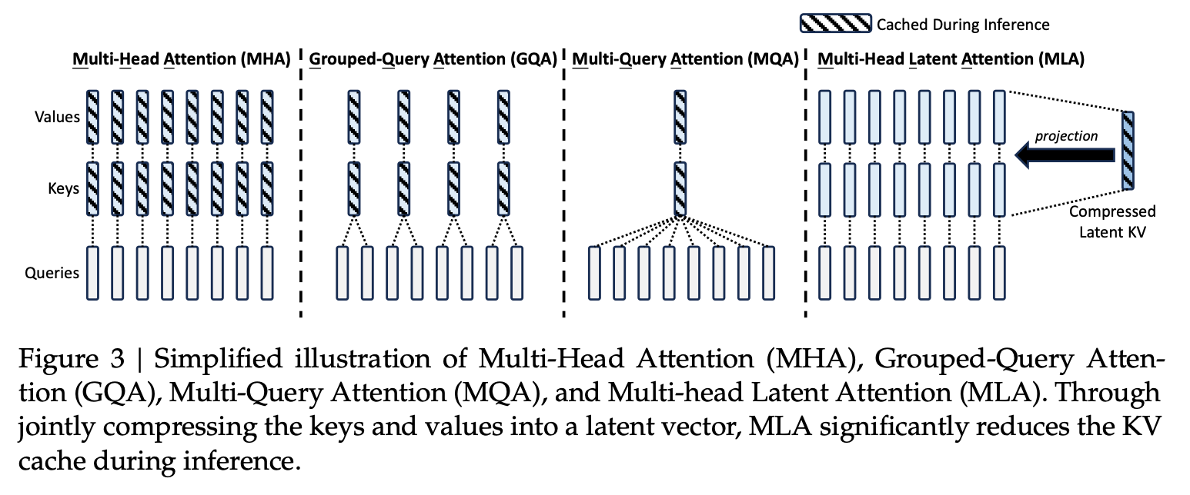
What is MLA？
MLA (Multi-head Latent Attention)¹ is a innovative attention architecture introduced by the DeepSeek-AI team.
¹DeepSeek-V2: A Strong, Economical, and Efficient Mixture-of-Experts Language Model (https://arxiv.org/pdf/2405.04434)
Notes:
MLA means Multi-head Latent Attention. It’s an innovative attention architecture introduced by the DeepSeek-AI Team.
Actually, there are serval attention architectures.
MHA is a conventional architecture. The kv cache is very heavy.
GQA and MQA reduced the KV cache by sharing kv over heads.
MLA innovatively introduced the low-rank projection to compress the kv cache into a latent vector, which significantly reduced the inference-time KV cache. So we can achieve higher throughput.

Slide 5
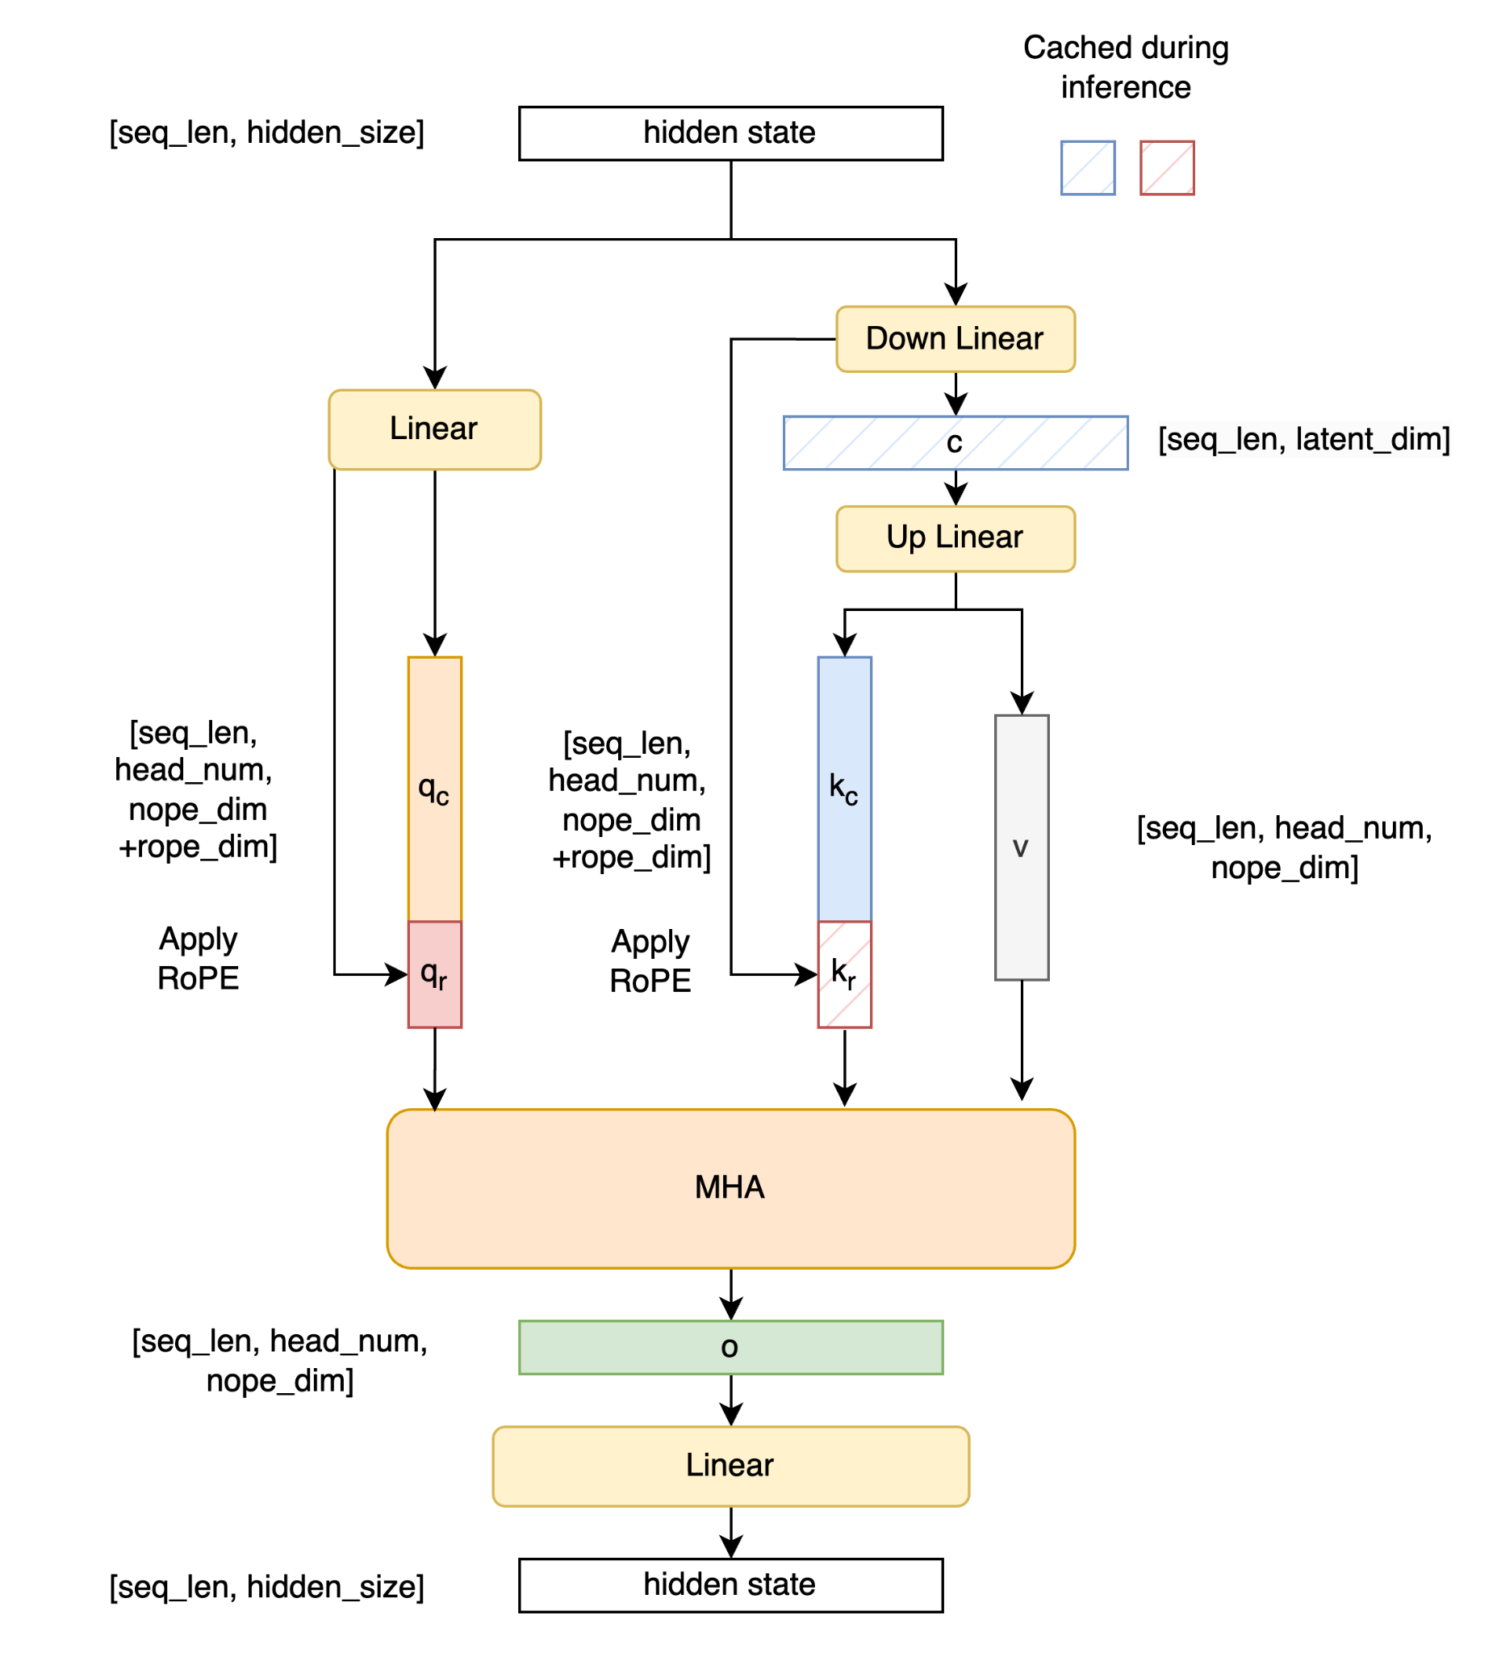
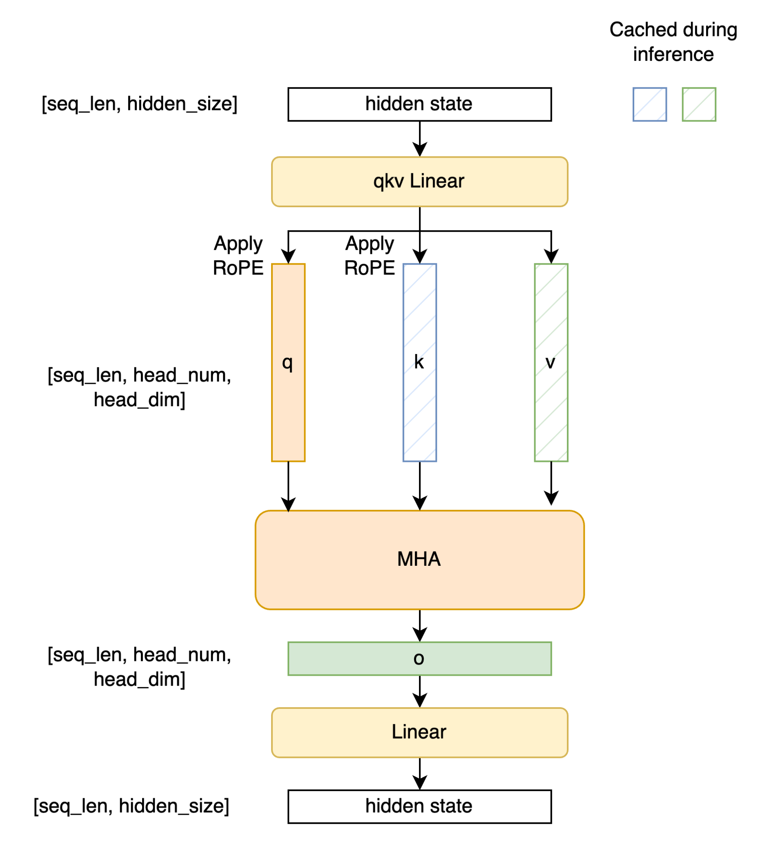
Computation Overview
MHA
MLA
Notes:
Let’s overview the computation process.
The MHA computation is very straightforward.
The MLA added mainly three changes on the MHA process:
The first is adding the Down linear layer to get the latent vector and up linear layer to project it to k and v.
The second is seperating the q and k into no rotary part and rotary embedding part of q and k. So that we can apply weight absorption on no rotary part.
The third is the cached part is only the compressed latent vector and the rotary part of k.

Slide 6
2. SGLang MLA Optimizations

Slide 7
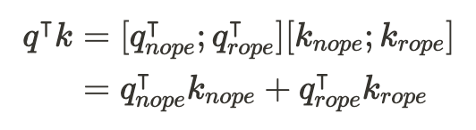
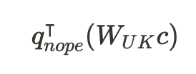







Weight Absorption
Change the computation order based on associative law of matrix multiplication.
①
orignal order
②
absorbed order
In DeepSeek-V2,
d = 128
dc = 512
h = 128
FLOPs:
In decoding stage (nq=1), the method ② can take less computation.
Notes:
The first optimization is the weight absorption. It’s the key optimization point mentioned in the paper.
Weight absorption means chaging the computation order by applying the associative law of matrix multiplication.
Here is an example of the qk computation.
The compuation overhead is different if we take different order to do matrix multiplication.
As computed, we can find if we absorb the Wuk weight matrix to the q first, it can take less computation in the decoding stage. Because the q length is one in docoding, the FLOPs of absorbed order is much small.

Slide 8
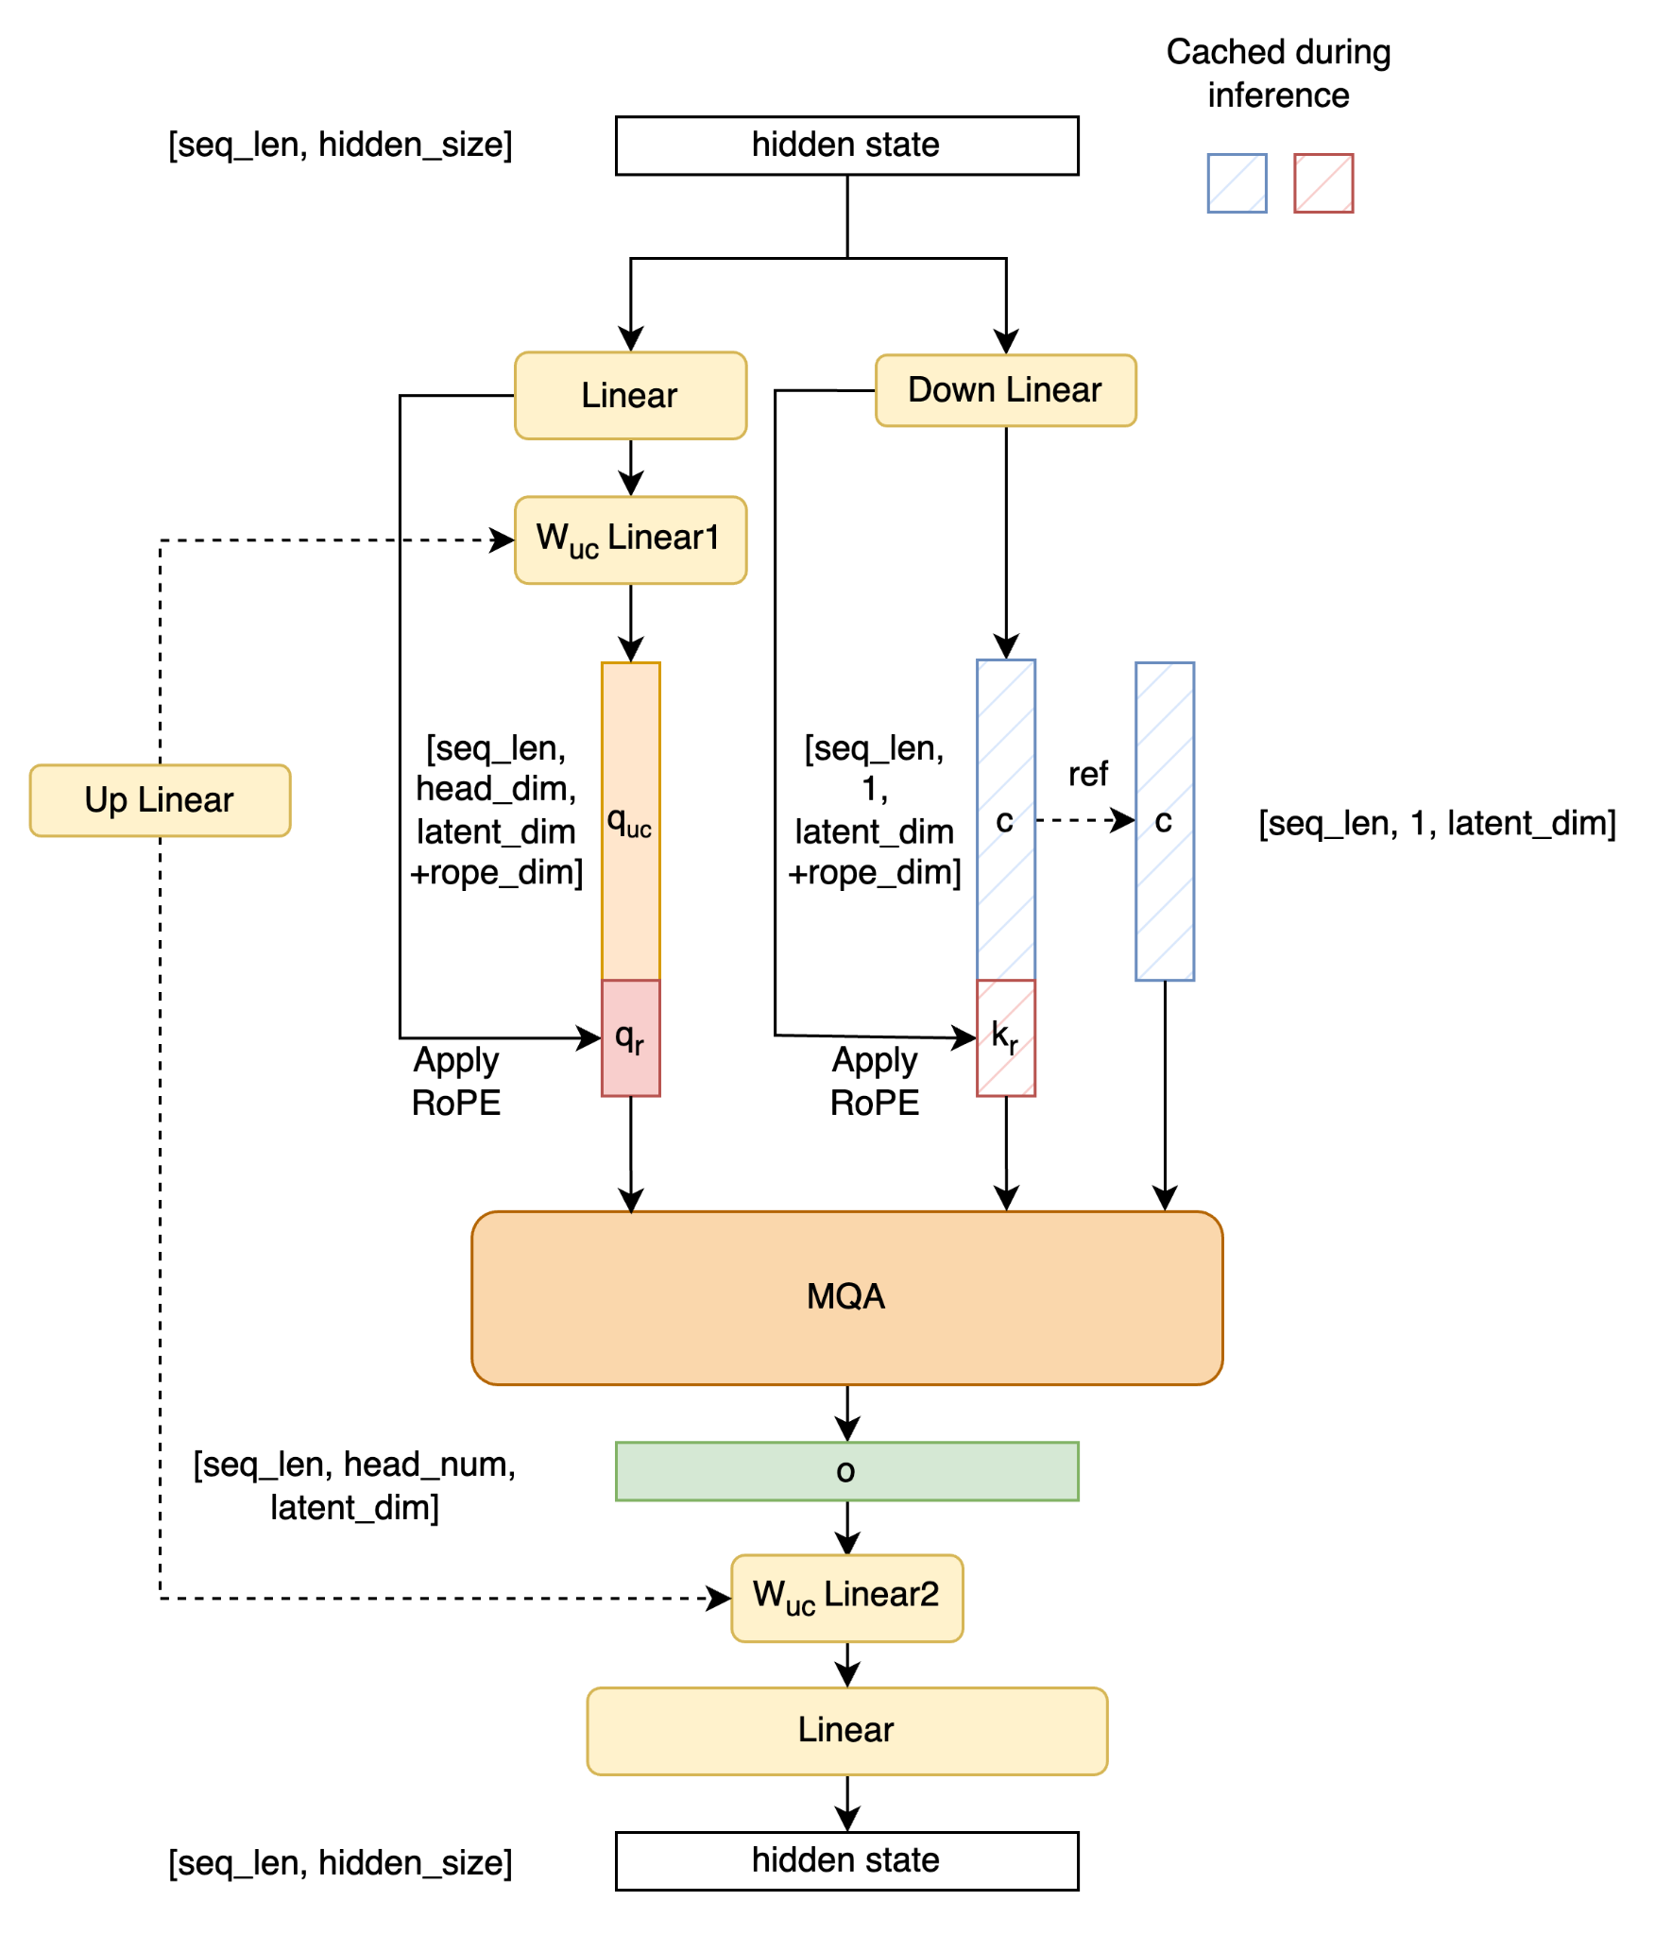
Weight Absorption
Original
w/ Weight Absorption
Notes:
Here is the computation change of weight absorption.
After weight absorption, the up linear layer is splited into two parts, and can be absorbed into q linear and o linear respectively.
Here, the k is the latent vector concatenated with the rotary part and the v is just the latent vector.
We implemented it based on MQA instead of MHA kernel, because the k and v have only one head here.
To be mentioned, the weight absorption cannot be applied to the rotary embedding part of q and k, that’s why it need to be seperated here. The detailed reason can be seen in the original paper.

Slide 9
Weight Absorption
Benefits:
Reduced overall computation in decoding stage
Balanced the computation and memory access in decoding kernel
Increased the attention computation intensity
Reduced the memory access of kv cache
Related PR: #905

Slide 10
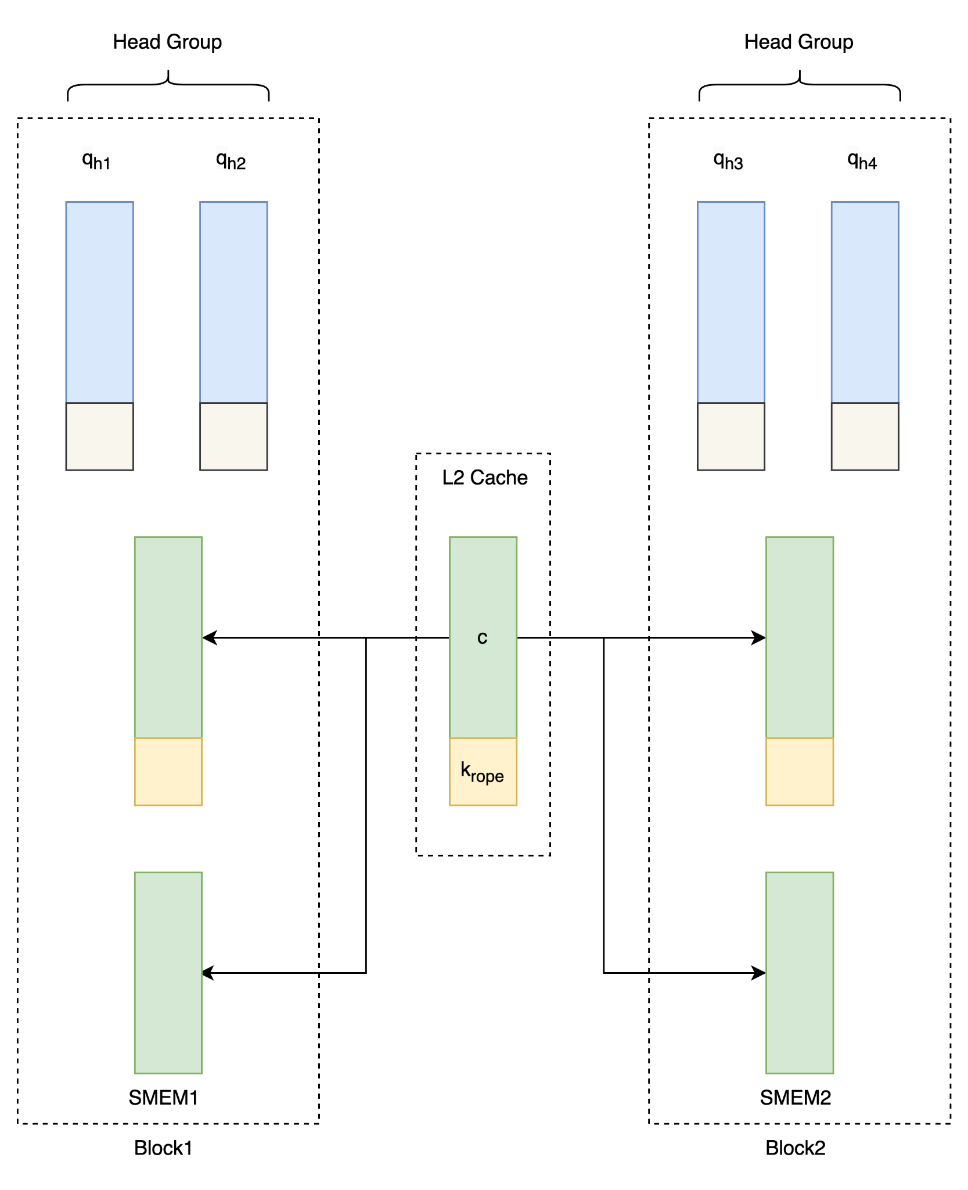
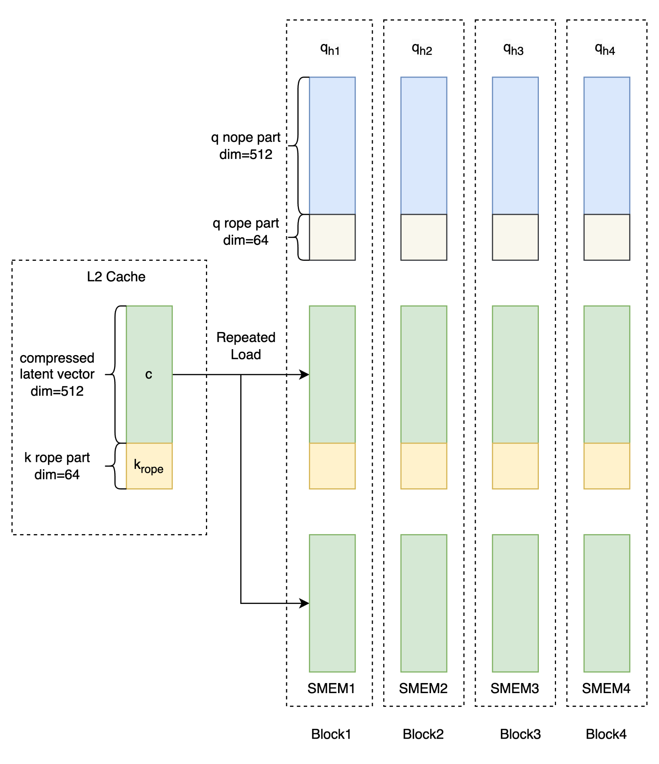
Groupped Decoding Kernel
We optimized the memory access of Triton decoding kernel for MLA.
Notes:
We optimizaed the memory access of the Triton decoding kernel for MLA.
We are using the MQA setting, that’s the k and v will be repeated read to each blocks to do the computation.
Previously, one triton block will only process one q head. For example, in the left figure, we have for q head, so we use for blocks to handle them, the k and v will be read four times from the L2 cache.
Now we use one block to handle a group of q heads, that can reduce the memory load a lot.

Slide 11
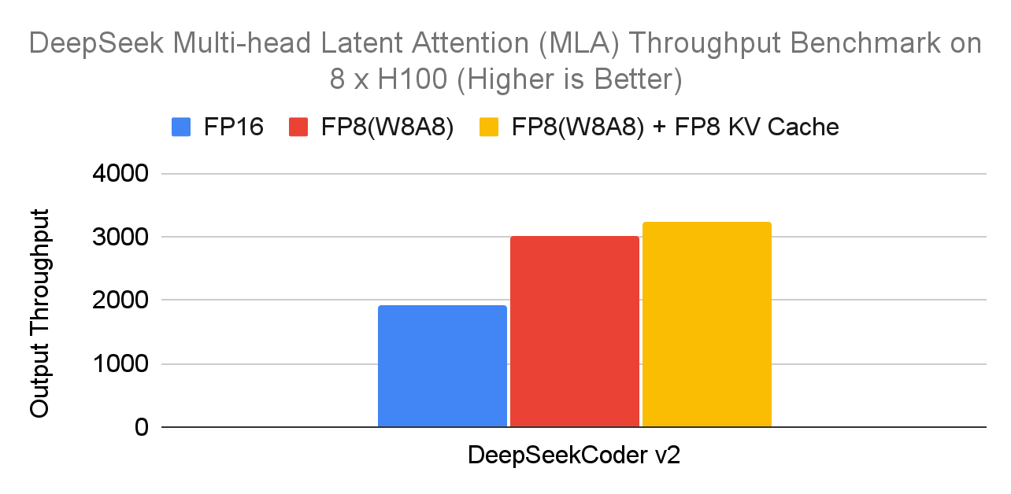
Quantization
Related PR: #469, #1285, #1286
Limitations:
torch compile not support FP8; W8A8 only support sm89+; FP8 KV Cache only support E5M2 for now
Notes:
DeepSeek in SGLang supports W8A8 and FP8 KV Cache. When W8A8 is enabled, the throughput increases by 57% compared to fp16. When both W8A8 and fp8 kv cache are enabled, the throughput increases by 70% compared to fp16.

Slide 12
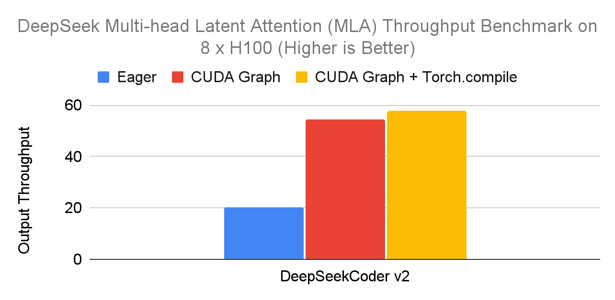
CUDA Graph & Torch Compile
Related PR: #1401, #1469, #1442
Workaround: #1446(FusedMoE skipped for torch compile)
Notes:
With input length 512, output length 512, and batch size 1, enabling CUDA graph and Torch compile has increased throughput by 1.7 times.

Slide 13
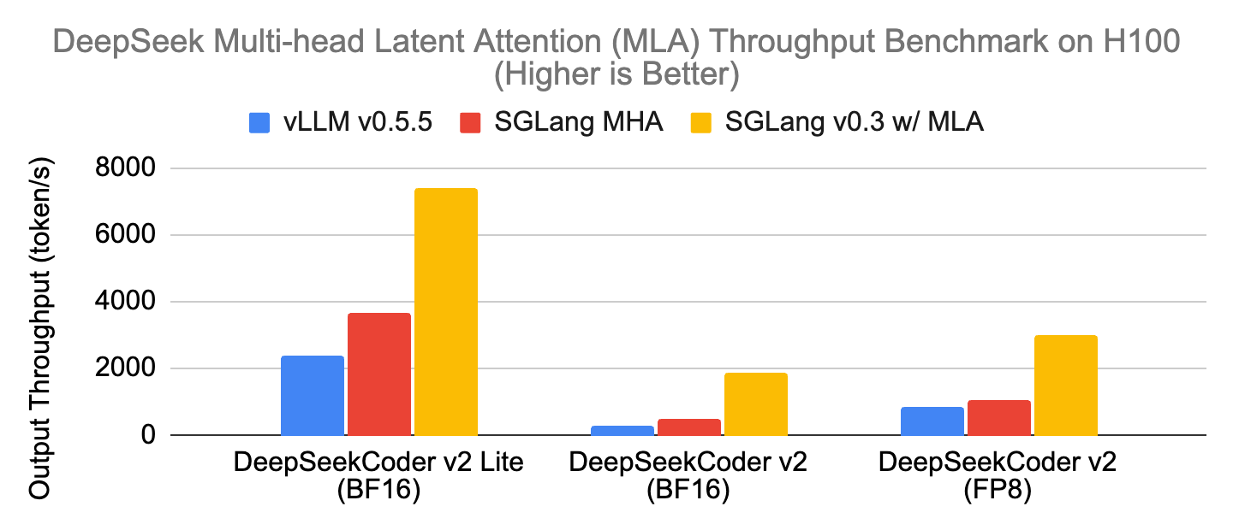
End2end Benchmark
source and setup: https://lmsys.org/blog/2024-09-04-sglang-v0-3/
Notes:
The throughput has improved significantly compared to MHA. In the case of bf16, it has increased by 7 times.

Slide 14
3. How to Use MLA in SGLang

Slide 15
How to Use MLA in SGLang
Recommend using the latest version(>=v0.3.1.post3).
# fp16 tp8
python3 -m sglang.launch_server --model deepseek-ai/DeepSeek-Coder-V2-Instruct --tp 8 --trust-remote-code
# fp16 tp8 w/ torch compile
python3 -m sglang.launch_server --model deepseek-ai/DeepSeek-Coder-V2-Instruct --tp 8 --trust-remote-code --enable-torch-compile
# fp16 tp8 w/ torch compile, max torch compile batch size 1
python3 -m sglang.launch_server --model deepseek-ai/DeepSeek-Coder-V2-Instruct --tp 8 --trust-remote-code --enable-torch-compile --max-torch-compile-bs 1
# fp8 tp8, fp8 e5m2 kv cache
python3 -m sglang.launch_server --model neuralmagic/DeepSeek-Coder-V2-Instruct-FP8 --tp 8 --trust-remote-code --kv-cache-dtype fp8_e5m2

Slide 16
4. Future Work

Slide 17
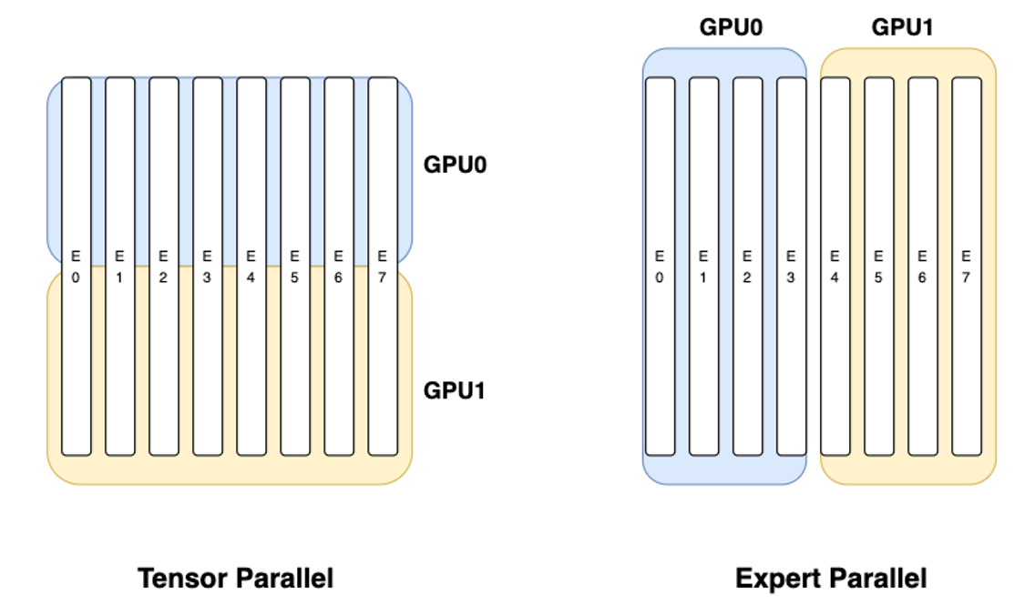
Future Work
MoE use TP or EP, Attention use DP
torch.compile for MoE layers
Separate prefill and decoding
Kernel optimizations (FlashInfer support)
FP8 KV Cache support E4M3
Notes:
While Expert Parallel evenly distributes some of the experts’ full weight to different GPUs, which means each GPU holds part of the experts’ full weight.

Slide 18
Welcome to join our Slack and use SGLang!

